Slide 1
Image Processing Lecture 7

Slide 2
Template Matching
Template matching is a technique in digital processing for finding small parts of an image.
A basic method of template matching uses a convolution mask called template.
We will call the search image S(x,y), where (x,y) represent the coordinates of each pixel in the search image. And template T(xt,yt) represents the coordinates of each pixel in the template.

Slide 3
Algorithm
Image preprocessing
Implementing coarse matching and finding matching candidates
Implementing image registration and outputting the translation, rotation and scaling parameters
Image rectification
Implementing fine matching and outputting the position at pixel level
Implementing subpixel interpolation and outputting the precious position of the subpixel.

Slide 4
Definition
Technique used in classifying objects.
Template Matching techniques compare portions of images against one another.
Sample image may be used to recognize similar objects in source image.
If standard deviation of the template image compared to the source image is small enough, template matching may be used.
Templates are most often used to identify printed characters, numbers, and other small, simple objects.

Slide 5
Method
I(x,y)
O(x,y)
x,y
Correlation
x,y
Template Image
Input Image
Output Image
The matching process moves the template image to all possible positions in a larger source image and computes a numerical index that indicates how well the template matches the image in that position.
Match is done on a pixel-by-pixel basis.

Slide 6

Template is a small image, usually a bi-level image.
Find template in source image, with a Yes/No approach.
Template
Source

Slide 7
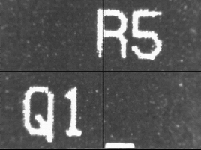

When using template-matching scheme on grey-level image it is unreasonable to expect a perfect match of the grey levels.
Instead of yes/no match at each pixel, the difference in level should be used.
Template
Source Image

Slide 8
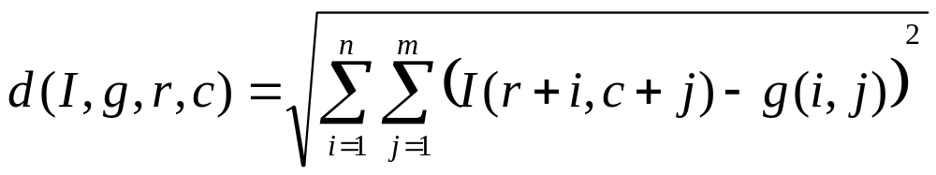
Euclidean Distance
Let I be a gray level image
and g be a gray-value template of size n×m.
In this formula (r,c) denotes the top left corner of template g.

Slide 9
Correlation
Correlation is a measure of the degree to which two variables agree, not necessary in actual value but in general behavior.
The two variables are the corresponding pixel values in two images, template and source.

Slide 10
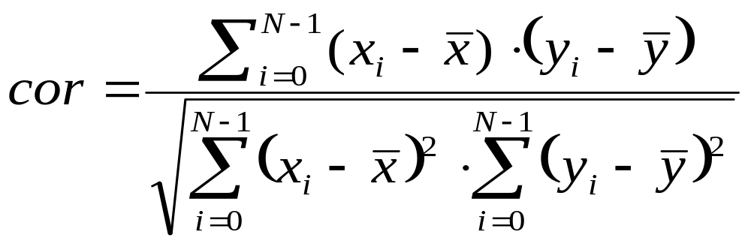
Grey-Level
Correlation Formula
x is the template gray level image
x is the average grey level in the template image
y is the source image section
y is the average grey level in the source image
N is the number of pixels in the section image
(N= template image size = columns * rows)
The value cor is between –1 and +1,
with larger values representing a stronger relationship between the two images.

Slide 11
Correlation is Computation Intensive
Template image size: 53 x 48
Source image size: 177 x 236
Assumption: template image is inside the source image.
Correlation (search) matrix size: 124 x 188 (177-53 x 236-48)
Computation count
  124 x 188 x 53 x 48 = 59,305,728

Slide 12
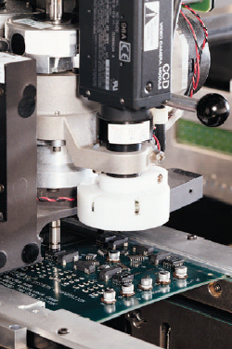
Machine Vision Example
Load printed circuit board into a machine
Teach template image (select and store)
Load printed circuit board
Capture a source image and find template

Slide 13
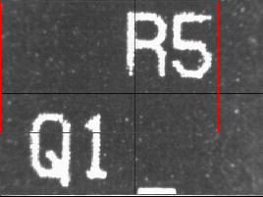
Machine Vision Example
Assumptions and Limitations
1. Template is entirely located in source image
2. Partial template matching was not performed (at boundaries, within image)
3. Rotation and scaling will cause poor matches

Slide 14
Introduction to
Morphological Operators

Slide 15
EROSION

Slide 16
What We Do Today. 2nd Part
Introduction to Morphological Operators
  Used generally on binary images, e.g., background subtraction results!
  Used on gray value images, if viewed as a stack to binary images.
Good for, e.g.,
  Noise removal in background
  Removal of holes in foreground / background
Check: www.cee.hw.ac.uk/hipr

Slide 17
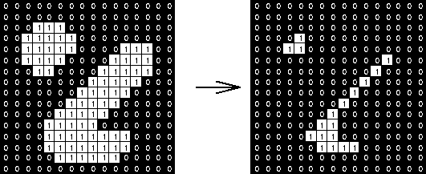
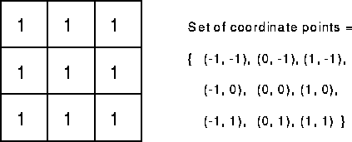
A first Example: Erosion
Erosion is an important morphological operation
Applied Structuring Element:

Slide 18
Example for Erosion
Input image
1 | 0 | 0 | 0 | 1 | 1 | 1 | 0 | 1 | 1
Structuring Element
1
1
1
Output Image
 | 0

Slide 19
Example for Erosion
Input image
1 | 0 | 0 | 0 | 1 | 1 | 1 | 0 | 1 | 1
Structuring Element
1
1
1
Output Image
 | 0 | 0

Slide 20
Example for Erosion
Input image
1 | 0 | 0 | 0 | 1 | 1 | 1 | 0 | 1 | 1
Structuring Element
1
1
1
Output Image
 | 0 | 0 | 0

Slide 21
Example for Erosion
Input image
1 | 0 | 0 | 0 | 1 | 1 | 1 | 0 | 1 | 1
Structuring Element
1
1
1
Output Image
 | 0 | 0 | 0 | 0

Slide 22
Example for Erosion
Input image
1 | 0 | 0 | 0 | 1 | 1 | 1 | 0 | 1 | 1
Structuring Element
1
1
1
Output Image
 | 0 | 0 | 0 | 0 | 1

Slide 23
Example for Erosion
Input image
1 | 0 | 0 | 0 | 1 | 1 | 1 | 0 | 1 | 1
Structuring Element
1
1
1
Output Image
 | 0 | 0 | 0 | 0 | 1 | 0

Slide 24
Example for Erosion
Input image
1 | 0 | 0 | 0 | 1 | 1 | 1 | 0 | 1 | 1
Structuring Element
1
1
1
Output Image
 | 0 | 0 | 0 | 0 | 1 | 0 | 0

Slide 25
Example for Erosion
Input image
1 | 0 | 0 | 0 | 1 | 1 | 1 | 0 | 1 | 1
Structuring Element
1
1
1
Output Image
 | 0 | 0 | 0 | 0 | 1 | 0 | 0 | 0

Slide 26
Introduction
Structuring Element
Erosion
Dilation
Opening
Closing
Outlook: Hit-and-miss Operation, Thinning, Thickening

Slide 27
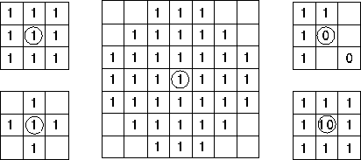
Structuring Element (Kernel)
Structuring Elements can have varying sizes
Usually, element values are 0,1 and none(!)
Structural Elements have an origin
For thinning, other values are possible
Empty spots in the Structuring Elements are don’t care’s!
Box
Disc
Examples of stucturing elements

Slide 28
Dilation & Erosion
Basic operations
Are dual to each other:
  Erosion shrinks foreground, enlarges Background
  Dilation enlarges foreground, shrinks background

Slide 29
Erosion
Erosion is the set of all points in the image, where the structuring element “fits into”.
Consider each foreground pixel in the input image
  If the structuring element fits in, write a “1” at the origin of the structuring element!
Simple application of pattern matching
Input:
  Binary Image (Gray value)
  Structuring Element, containing only 1s!

Slide 30


Another example of erosion
White = 0, black = 1, dual property, image as a result of erosion gets darker

Slide 31
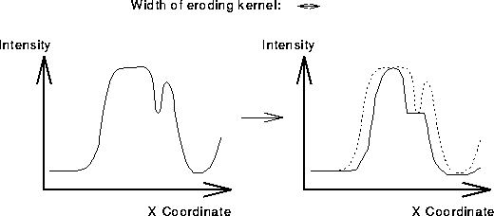
Erosion on Gray Value Images
View gray value images as a stack of binary images!

Slide 32
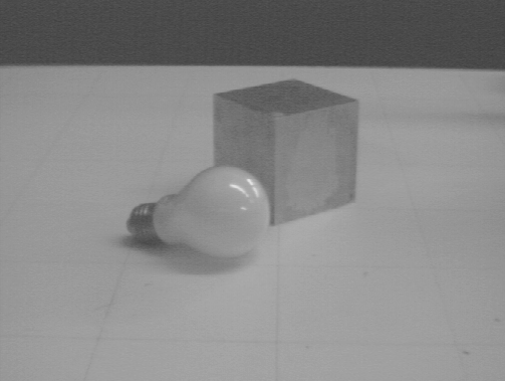
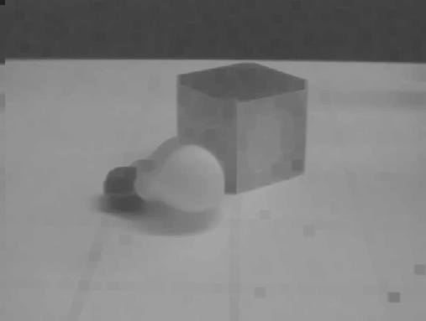
Erosion on Gray Value Images
Images get darker!

Slide 33
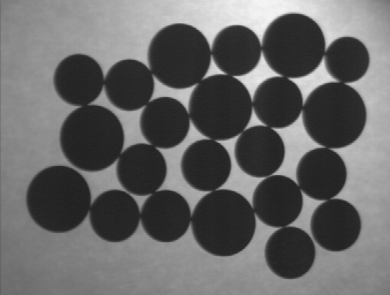
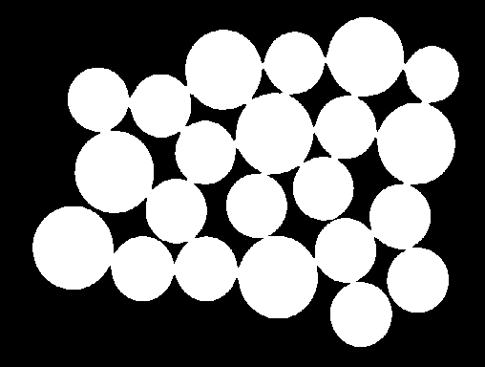

Counting Coins
Counting coins is difficult because they touch each other!
Solution: Binarization and Erosion separates them!

Slide 34
DILATION

Slide 35
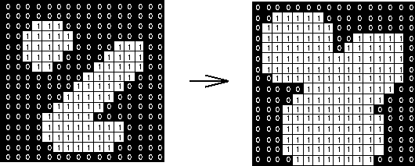
Example: Dilation
Dilation is an important morphological operation
Applied Structuring Element:

Slide 36
Dilation
Dilation is the set of all points in the image, where the structuring element “touches” the foreground.
Consider each pixel in the input image
  If the structuring element touches the foreground image, write a “1” at the origin of the structuring element!
Input:
  Binary Image
  Structuring Element, containing only 1s!!

Slide 37
Example for Dilation
Input image
1 | 0 | 0 | 0 | 1 | 1 | 1 | 0 | 1 | 1
Structuring Element
1
1
1
Output Image
 | 1

Slide 38
Example for Dilation
Input image
1 | 0 | 0 | 0 | 1 | 1 | 1 | 0 | 1 | 1
Structuring Element
1
1
1
Output Image
 | 1 | 0

Slide 39
Example for Dilation
Input image
1 | 0 | 0 | 0 | 1 | 1 | 1 | 0 | 1 | 1
Structuring Element
1
1
1
Output Image
 | 1 | 0 | 1

Slide 40
Example for Dilation
Input image
1 | 0 | 0 | 0 | 1 | 1 | 1 | 0 | 1 | 1
Structuring Element
1
1
1
Output Image
 | 1 | 0 | 1 | 1

Slide 41
Example for Dilation
Input image
1 | 0 | 0 | 0 | 1 | 1 | 1 | 0 | 1 | 1
Structuring Element
1
1
1
Output Image
 | 1 | 0 | 1 | 1 | 1

Slide 42
Example for Dilation
Input image
1 | 0 | 0 | 0 | 1 | 1 | 1 | 0 | 1 | 1
Structuring Element
1
1
1
Output Image
 | 1 | 0 | 1 | 1 | 1 | 1

Slide 43
Example for Dilation
Input image
1 | 0 | 0 | 0 | 1 | 1 | 1 | 0 | 1 | 1
Structuring Element
1
1
1
Output Image
 | 1 | 0 | 1 | 1 | 1 | 1 | 1

Slide 44
Example for Dilation
Input image
1 | 0 | 0 | 0 | 1 | 1 | 1 | 0 | 1 | 1
Structuring Element
1
1
1
Output Image
 | 1 | 0 | 1 | 1 | 1 | 1 | 1 | 1

Slide 45

Another Dilation Example
Image get lighter, more uniform intensity

Slide 46
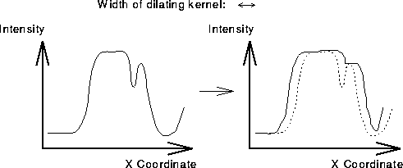
Dilation on Gray Value Images
View gray value images as a stack of binary images!

Slide 47
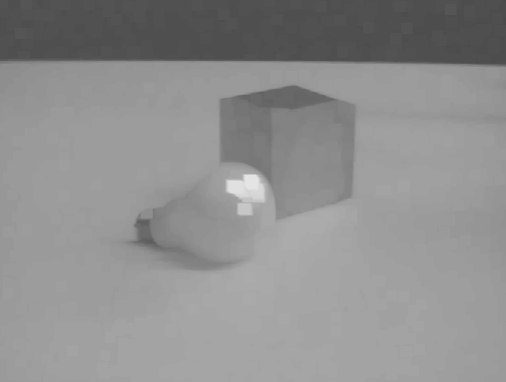
Dilation on Gray Value Images
More uniform intensity

Slide 48
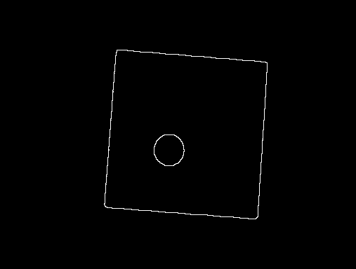
Edge Detection
Edge Detection
Dilate input image
Subtract input image from dilated image
Edges remain!

Slide 49
Opening & Closing
Important operations
Derived from the fundamental operations
  Dilatation
  Erosion
Usually applied to binary images, but gray value images are also possible
Opening and closing are dual operations

Slide 50
OPENING

Slide 51
Opening
Similar to Erosion
  Spot and noise removal
  Less destructive
Erosion next dilation
the same structuring element for both operations.
Input:
  Binary Image
  Structuring Element, containing only 1s!

Slide 52
Opening
Take the structuring element (SE) and slide it around inside each foreground region.
  All pixels which can be covered by the SE with the SE being entirely within the foreground region will be preserved.
  All foreground pixels which can not be reached by the structuring element without lapping over the edge of the foreground object will be eroded away!
Opening is idempotent: Repeated application has no further effects!

Slide 53

Opening
Structuring element: 3x3 square

Slide 54


Opening Example
Opening with a 11 pixel diameter disc

Slide 55

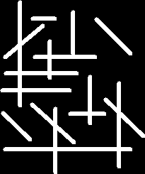

Opening Example
3x9 and 9x3 Structuring Element
3*9
9*3

Slide 56
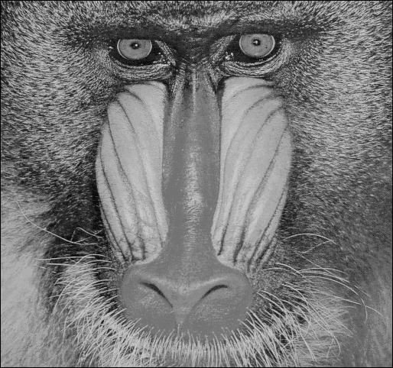
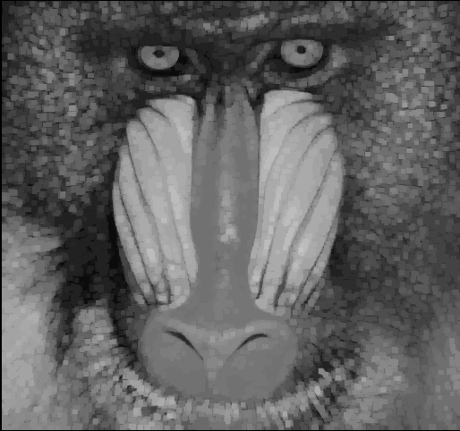
Opening on Gray Value Images
5x5 square structuring element

Slide 57
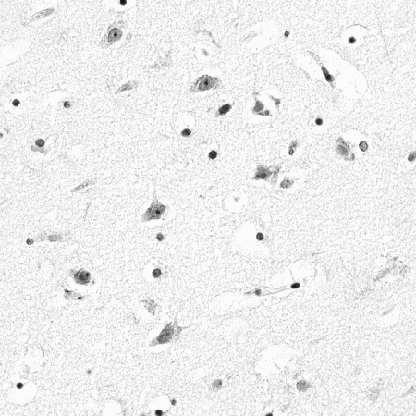
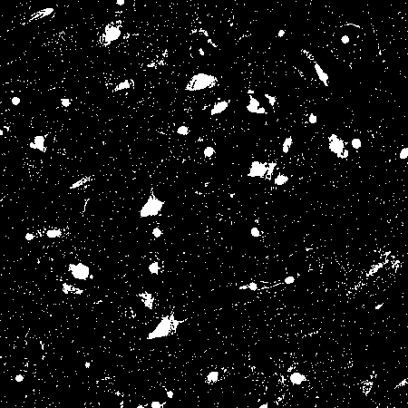
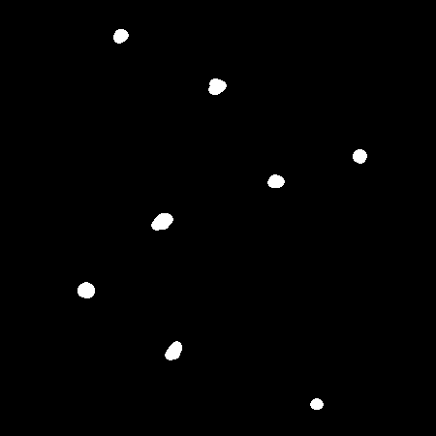
Use Opening for Separating Blobs
Use large structuring element that fits into the big blobs
Structuring Element: 11 pixel disc

Slide 58
CLOSING

Slide 59
Closing
Similar to Dilation
  Removal of holes
  Tends to enlarge regions, shrink background
Closing is defined as a Dilatation, followed by an Erosion using the same structuring element for both operations.
Dilation next erosion!
Input:
  Binary Image
  Structuring Element, containing only 1s!

Slide 60
Closing
Take the structuring element (SE) and slide it around outside each foreground region.
  All background pixels which can be covered by the SE with the SE being entirely within the background region will be preserved.
  All background pixels which can not be reached by the structuring element without lapping over the edge of the foreground object will be turned into a foreground.
Opening is idempotent: Repeated application has no further effects!

Slide 61

Closing
Structuring element: 3x3 square

Slide 62


Closing Example
Closing operation with a 22 pixel disc
Closes small holes in the foreground

Slide 63



Closing Example 1
Threshold
Closing with disc of size 20
Thresholded closed

Slide 64
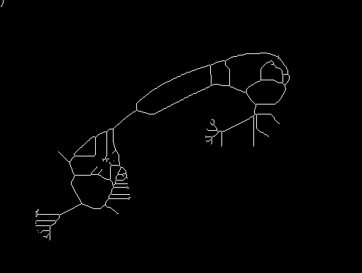
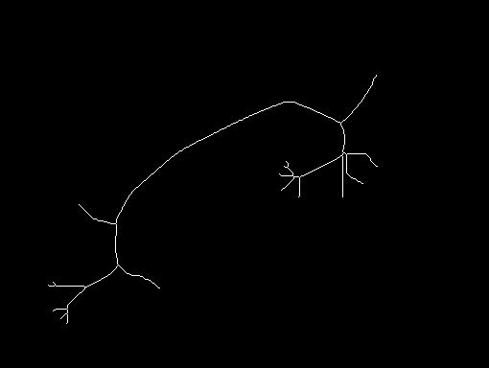
Closing Example 2
Good for further processing: E.g. Skeleton operation looks better for closed image!
skeleton of Thresholded
skeleton of Thresholded and next closed

Slide 65
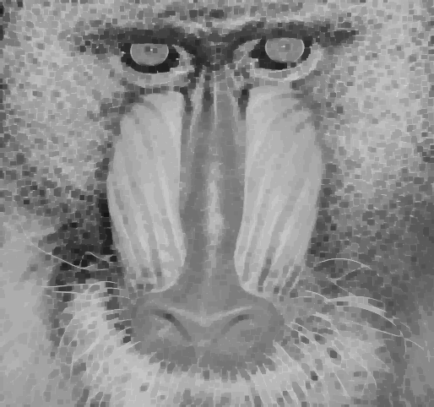
Closing Gray Value Images
5x5 square structuring element

Slide 66
Opening & Closing
Opening is the dual of closing
i.e. opening the foreground pixels with a particular structuring element
is equivalent to closing the background pixels with the same element.

Slide 67
HIT and MISS

Slide 68
Hit-and-miss Transform
Used to look for particular patterns of foreground and background pixels
Very simple object recognition
All other morphological operations can be derived from it!!
Input:
  Binary Image
  Structuring Element, containing 0s and 1s!!

Slide 69
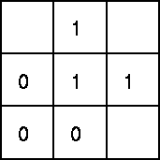
Hit-and-miss Transform
Example for a Hit-and-miss Structuring Element
Contains 0s, 1s and don’t care’s.
Usually a “1” at the origin!

Slide 70
Hit-and-miss Transform
Similar to Pattern Matching:
If foreground and background pixels in the structuring element exactly match foreground and background pixels in the image, then the pixel underneath the origin of the structuring element is set to the foreground color.

Slide 71
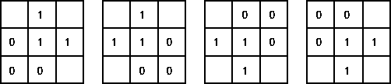
Corner Detection with Hit-and-miss Transform
Structuring Elements representing four corners

Slide 72

Corner Detection with Hit-and-miss Transform
Apply each Structuring Element
Use OR operation to combine the four results

Slide 73
Basic THINNING

Slide 74
Thinning
Used to remove selected foreground pixels from binary images
After edge detection, lines are often thicker than one pixel.
Thinning can be used to thin those line to one pixel width.

Slide 75
Definition of Thinning
Let K be a kernel and I be an image
with 0-1=0!!
If foreground and background fit the structuring element exactly, then the pixel at the origin of the SE is set to 0
Note that the value of the SE at the origin is 1 or don’t care!

Slide 76
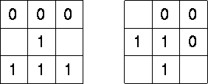
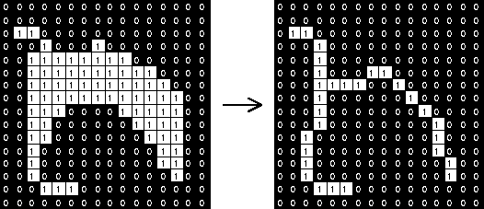
Example Thinning
We use two Hit-and-miss Transforms

Slide 77
Basic THICKENING

Slide 78
Thickening
Used to grow selected regions of foreground pixels
E.g. applications like approximation of convex hull

Slide 79
Definition Thickening
Let K be a kernel and I be an image
with 1+1=1
If foreground and background match exactly the SE, then set the pixel at its origin to 1!
Note that the value of the SE at the origin is 0 or don’t care!

Slide 80



Example Thickening

Slide 81
PROBLEMS

Slide 82
Problems
Consider the images on slide 17! Why are the images getting darker under erosion? Explain!
Consider the images on slide 31! Why are the intensities becoming more uniform? Explain!
Compare Dilatation and Erosion! How are they related? Verify your answers with Matlab!
Apply Erosion and Dilatation for noise removal!
Consider slide 38: Remove the artefacts remaining with the horizontal lines.

Slide 83
Problems
Derive dilatation and erosion from the Hit-and-miss transformation

Slide 84
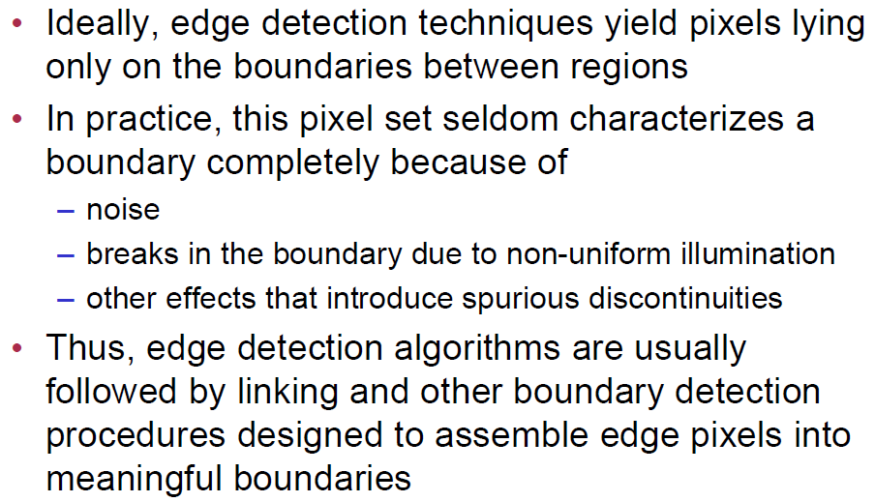
Edge Linking and boundary detection

Slide 85
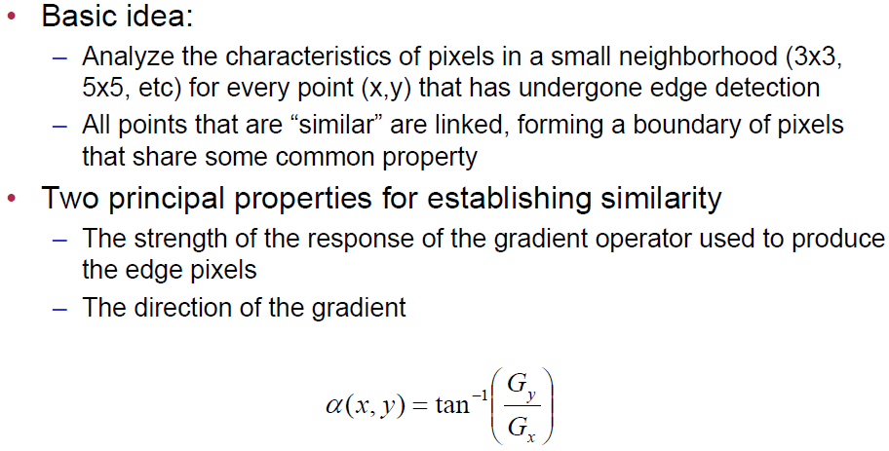
Edge Linking : local processing

Slide 86
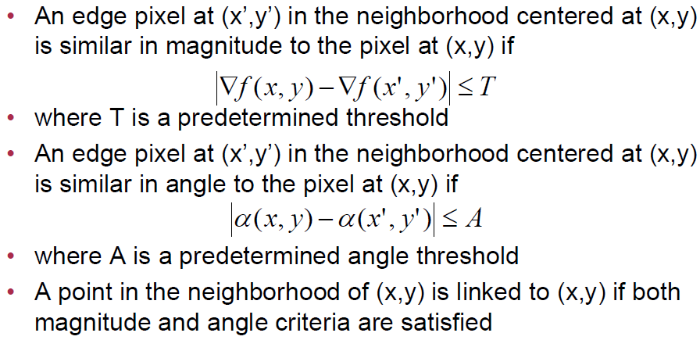
Edge Linking : local processing

Slide 87
Thank You

